Slide 1
Hardware CWE™ Special Interest Group (SIG)
Gananand Kini, Luke Malinowski, Chris Lathrop, Bob Heinemann, Steve Christey Coley, Alec Summers
MITRE
February 18, 2022

Slide 2
Agenda
Working Items for this meeting:
Hardware technology names and classes
Public Collaboration Tools
Hardware/Software/Firmware and CWE
Next meeting –
CWE Scope Issues (including CWE-1324 and CWE-submissions from Paul W.)
Hardware Description Language in Language enumeration
Improving Existing HW CWE mitigations for current HW CWE entries

Slide 3
Housekeeping
Schedule:
Next Meeting – Friday, March 18
12:30 – 1:30 PM EST
Microsoft Teams
Contact: cwe@mitre.org
Minutes from previous meetings available on our Github site:
https://github.com/CWE-CAPEC/hw-cwe-sig

Slide 4
Topic #1
Hardware technology names and classes

Slide 5
Is distinguishing Hardware Technology names and classes important?
What are some use cases for this field when applying CWE?
Some have specified using it to filter the CWE-1194 Hardware View. Use case for potentially using it for a future CWE API.
Potential to identify areas/gaps in CWE.
Notes:
Helps to classify weaknesses for applicability across functional areas.
Can help identify gaps – missing name/class fields can indicate lack of weaknesses in the missing category.

Slide 6
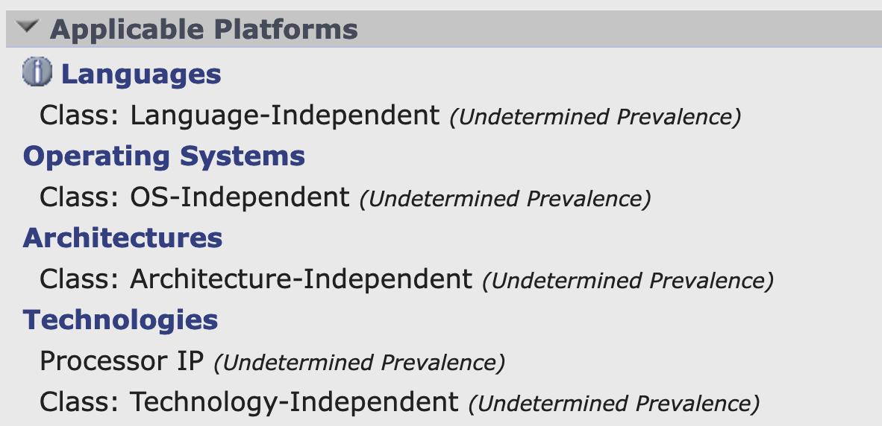
Hardware Technology Name
For Hardware, Technology Names has:
Accelerator IP
Analog and Mixed Signal IP
Audio/Video IP
Bus/Interface IP
Communication IP
Controller IP
Memory IP
Microcontroller IP
Network on Chip IP
Power Management IP
Processor IP
Security IP
Sensor IP
Storage IP
Test/Debug IP
Other
What gaps do you see here in terms of hardware technology name?

Slide 7
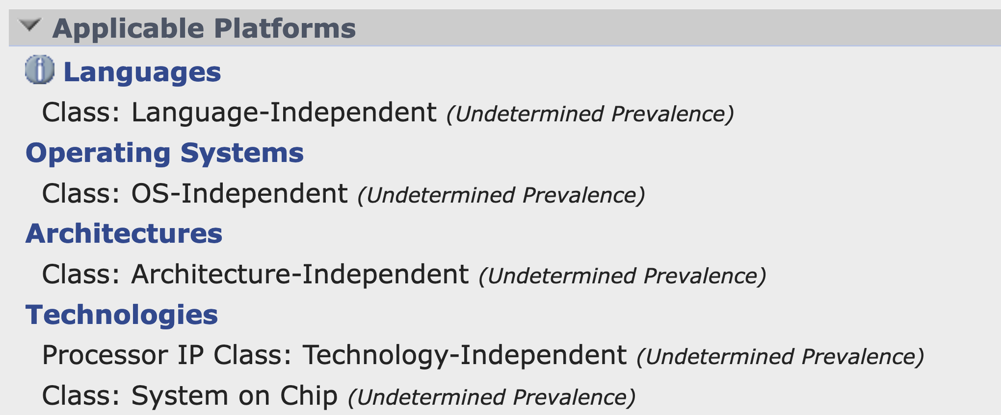
Hardware Technology Class
For Hardware, relevant Technology Class has:
Cloud Computing
Mainframe
Mobile
System on Chip
Technology-Independent
What are other domains of application of hardware?
What about Network-on-Chip?
Is it a domain or a specific application when distinguishing the application of a weakness?

Slide 8
Topic #2
Public collaboration Tools for the HW SIG

Slide 9
Did you know: HW SIG Mailing List!!!!
hw-cwe-special-interest-group-sig-list@mitre.org
You should already be added. Please let us know by emailing cwe@mitre.org if you are not.
Can be used for discussion amongst HW CWE SIG members.
Will send out a test email after this meeting with subject 'Test HW CWE SIG'.

Slide 10
GitHub, Teams, Mailing List
MITRE has already been using GitHub and Teams for HW SIG meetings along with the mailing list.
Are these tools useful for folks?
Do you have suggestions for tools to help:
Facilitate feedback on submissions,
Create and contribute to discussion topics,
Propose agenda items,
Present new information relevant to CWE/CAPEC,
Manage action items,
Host meeting minutes, and meeting videos potentially,
Shared calendars,
Please think about these and let us know!

Slide 11
Topic #3
Hardware / Software / Firmware and CWE

Slide 12
Mazda Infotainment Systems bricked (Feb 9, 2022)
Mazda’s in the Seattle area were stuck with bricked infotainment systems tuned to a specific radio station KUOW 94.9 FM. A specific signal during the day’s broadcast caused the screens to die and radios were stuck on 94.9 FM.
URL: https://arstechnica.com/cars/2022/02/radio-station-snafu-in-seattle-bricks-some-mazda-infotainment-systems/

Slide 13
Hardware / Software / Firmware
Hardware category – Weaknesses are organized around concepts frequently used or encountered in hardware design. (View 1194)
What are the explicit benefits of a clean distinction between Software, Firmware, and Hardware?
How do we define those terms such that we can make the distinction?
Are there any strong objections to making that distinction?

Slide 14
Next Meeting (March 18)
What would members of this body like to see for the next HW SIG agenda?
Questions, Requests to present? Please let us know.
CWE@MITRE.ORG

